Slide 1


Slide 2

Introduction Statement:
Children’s Ministry is not babysitting; it is foundational discipleship that shapes the future of the church.
Key statement:
“If we win the children, we win the future of the church.”
Reflect on your own childhood spiritual influence.

Slide 3
Biblical Foundation
A. God’s Heart for Children
Psalm 127:3 — Children are a heritage and reward.
Matthew 19:14 — Jesus welcomes children; the church must do the same.
Deuteronomy 6:6–7 — Discipleship begins early and is continuous.
Proverbs 22:6 — Early formation creates lifelong direction.

Slide 4
Biblical Foundation
B. Jesus’ Model
He taught children.
He protected children.
He used children as examples of faith.
Children’s Ministry should not be optional. If children mattered to Jesus, they must matter to us as His church.

Slide 5
Why Children’s Ministry Is Strategic
A. Spiritual Formation Happens Early
Research shows most believers come to Christ before age 14. Early years = highest receptivity.
B. Identity Formation
Children form their understanding of:
God, The Church, Themselves, Community, Purpose

Slide 6
Why Children’s Ministry Is Strategic
C. Family Impact
Strong Children’s Ministry strengthens:
Parent engagement
Church attendance
Multi‑generational discipleship

Slide 7
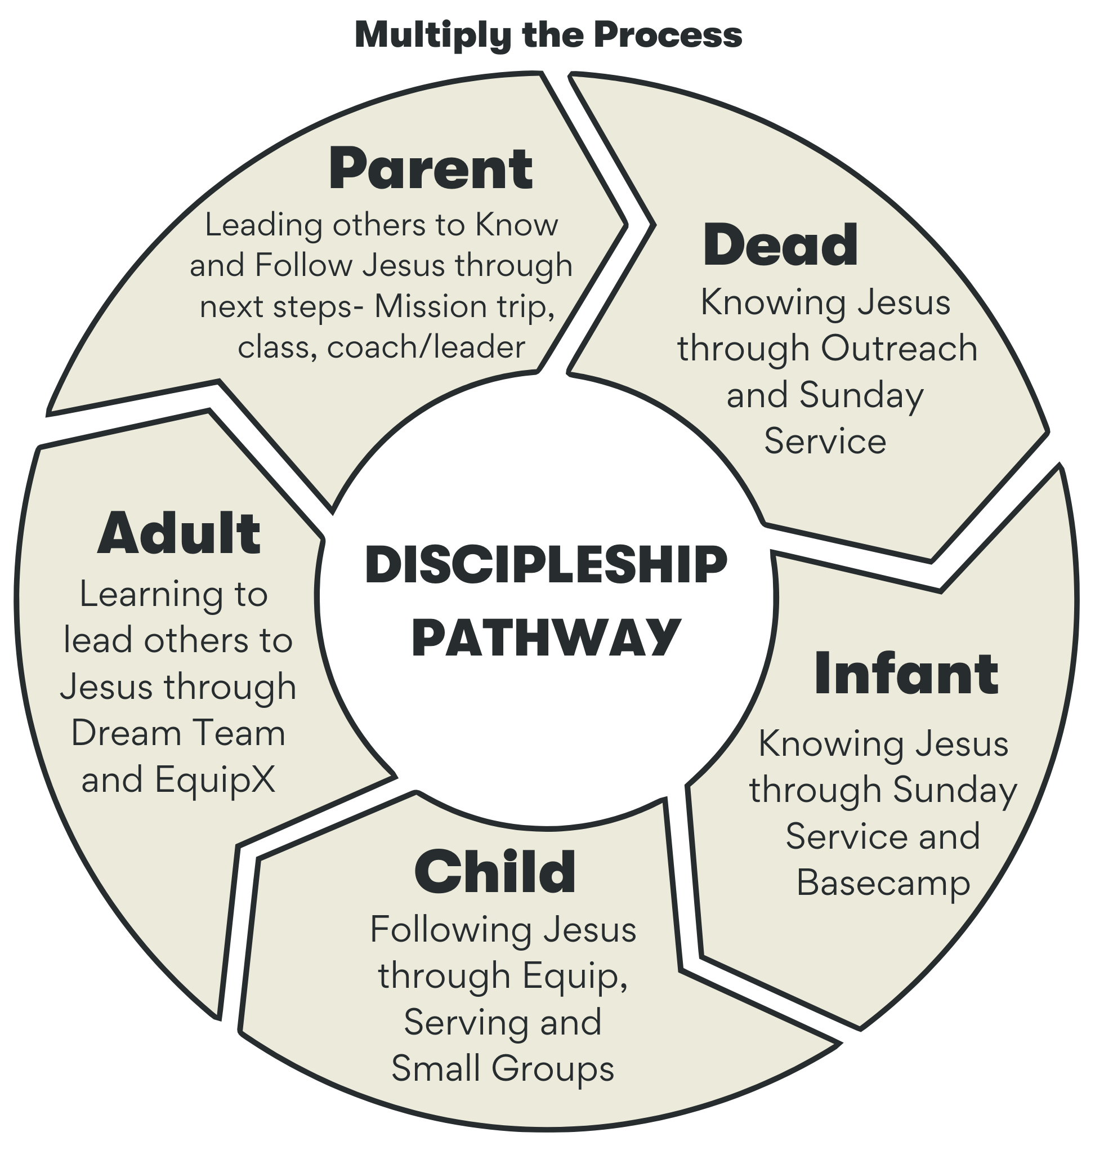
Why Children’s Ministry Is Strategic
D. Church Growth
Healthy Children’s Ministry attracts families and stabilizes congregations.

Slide 8
The Pastor’s Role
A. Vision Casting
Pastors must champion Children’s Ministry publicly and consistently.
B. Resourcing
Budget, Volunteers, Space, Curriculum

Slide 9
The Pastor’s Role
C. Modeling Value
When pastors show up, children feel seen and leaders feel supported.
D. Protecting the Ministry
Advocate for safety, Ensure training, Maintain standards

Slide 10
Safety & Protection
A. Why Safety Matters
Children are vulnerable. The church must be the safest place in their lives.
B. Core Safety Practices
Background checks, Two‑adult rule, Check‑in systems, Abuse reporting, Training.

Slide 11
Building a Healthy Children’s Ministry
A. Core Components
Biblical teaching
Worship
Small groups
Parent partnership
Special events

Slide 12
Building a Healthy Children’s Ministry
B. Volunteer Culture
Clear expectations, Training, Appreciation, Rotation schedules
C. Excellence Without Overwhelm
Start simple. Build steadily. Prioritize relationships over production.

Slide 13
Closing Challenge
Key Charge:
“If you invest in children, you invest in the future of your church, your community, and the Kingdom.”
Commit to championing Children’s Ministry as a central part of your calling.

Slide 14
Discussion Questions
What shaped your faith as a child
What barriers exist in your church
What first step can you take this month
How can you support your Children’s Ministry leader

