Slide 1
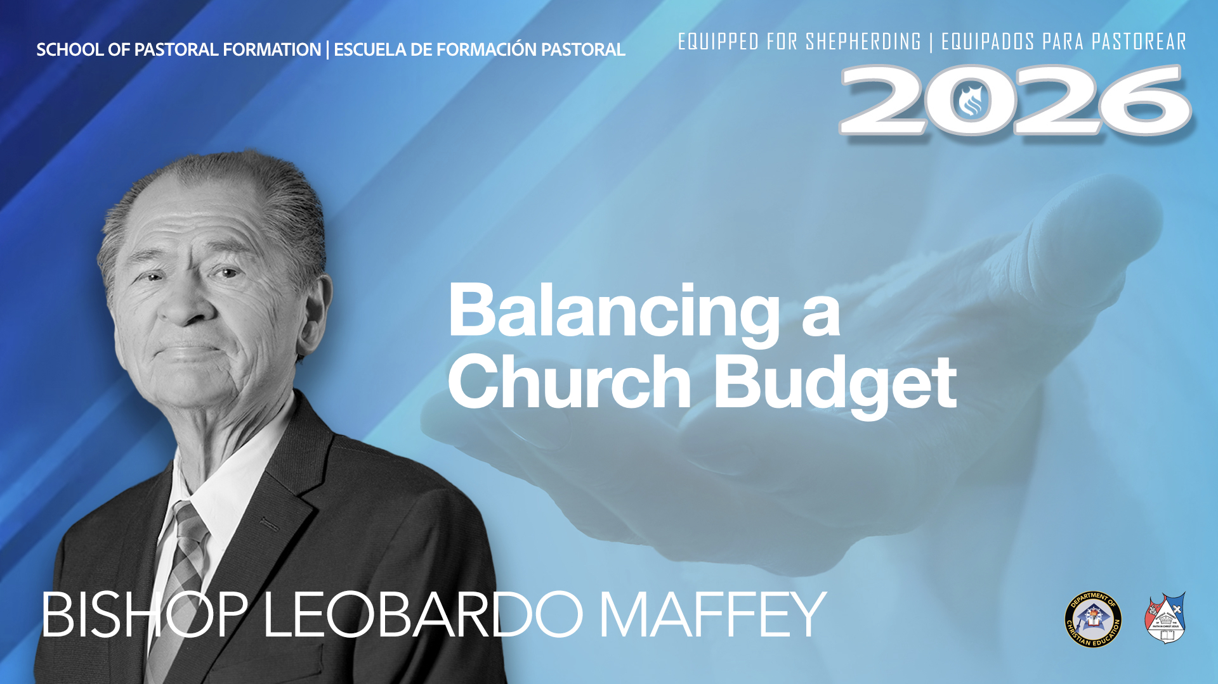

Slide 2

"For who among you, wanting to build a tower, does not first sit down and calculate the costs, to see if he has what he needs to finish it? Lest after he has laid the foundation, and cannot finish it, all who see him begin to mock him." Luke 14:28-29.
The financial budget is a detailed plan that estimates future income and expenses over a given period.
Its main objective is to provide a guide for the effective management of financial resources and to ensure that financial objectives are met.

Slide 3
The financial budget allows you to control resources and avoid unnecessary expenses.
By anticipating and planning income and expenses, it is possible to take corrective measures to avoid financial surprises and ensure economic stability.
For economic stability the church needs to be biblically taught about the blessings of tithes and offerings. 2 Corinthians 9:6-7

Slide 4
The pastor must be transparent about the church's expenses. 1 Corinthians 4:1-2
A man of integrity. (quality of being honest and having solid moral principles).
The church treasurer must render a detailed report of income and expenditure at a general meeting.
If you need to pay some bills or loans or save money for the purchase of another sanctuary or to invest in a project, the pastor should convey his vision to the church and invite the brothers to give $20 a month.

