Slide 1
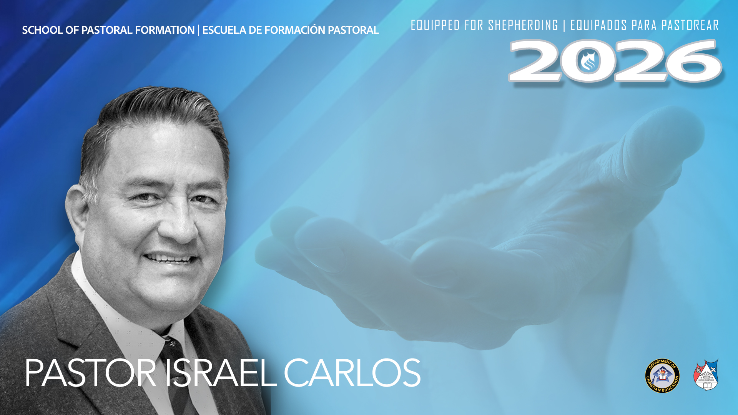
THE STRATEGY OF JESUS
Biblical Principles from David Yonggi Cho's Cell Ministry

Slide 2

THE STRATEGY OF JESUS
Biblical Principles from David Yonggi Cho's Cell Ministry
Pastor Israel Carlos

Slide 3
Session Objectives
• Understand the biblical foundation of house-to-house ministry
• Learn key Biblical principles from David Yonggi Cho
• Discover how churches can grow through discipleship and leadership multiplication
• Apply these principles in local congregations

Slide 4
I. Opening Questions
• Why do some churches grow while others plateau?
• Can every believer become involved in ministry?
• What structure is needed to care for growth?

Slide 5
II. The Biblical Pattern
Acts 2:46-47
Temple Ministry
• Worship
• Apostolic preaching
• Celebration
House-to-House Ministry
• Fellowship
• Prayer
• Evangelism
• Discipleship

Slide 6
Key Principle
The early church grew through BOTH large gatherings and small gatherings

Slide 7
III. The Case Study of David Yongii Chos

Slide 8
Who was David Yonggi Cho?
• Born in 1936 in South Korea
• Converted to Christ as a young man
• Began ministry in poverty
Notes:
Died Sept 14, 2021

Slide 9
Who was David Yonggi Cho?
• Founder of Yoido Full Gospel Church
• Leadership multiplication pioneer
• Developed one of history's most influential cell ministry models
Central Question: How can one pastor effectively grow & care for a congregation?

Slide 10
The Situation
Small church
Desire to reach more people
Limited pastoral capacity
One pastor cannot effectively care for hundreds of people alone

Slide 11
The Discovery
Move ministry from the pulpit to the people

Slide 12
The Result
• Thousands of cells
• Thousands of leaders
• Continuous evangelism
• Continuous discipleship
Notes:
Church Sount Korea grew to estimated 830k to 850k

Slide 13
Principle 1
The Church Must Grow Through Cells, Not Just Buildings

Slide 14
Principle 2
The Cell Is the Basic Unit of the Church

Slide 15
Principle 3
Every Cell Must Be Evangelistic

Slide 16
Principle 4
Multiplication is the Goal

Slide 17
Principle 5
Every member is a Minister

Slide 18
Principle 6
Prayer is the Engine of Cell Ministry

Slide 19
Principle 7
Leadership Development Never Stops

Slide 20
Principle 8
Woman can serve & lead

Slide 21
Principle 9
Cells & Celebration must work together

Slide 22
Principle 10
The Senior Pastor must champion the vision

Slide 23
Leadership Multiplication Model
Leader → Apprentice → New Cell → New Leaders

Slide 24
Application for Smaller Churches
Even churches of 50–150 members can benefit from:
• Home groups
• Personal discipleship
• Leadership development
• Evangelistic outreach

Slide 25
Discussion Questions
•Which principle is most needed in your church?
•What obstacles prevent multiplication?
•Who could be trained as future leaders?

Slide 26
Final Challenge
If your church doubled next year, could your current structure care for every new believer?

