Slide 1

2 TIMOTHY 2:15
Notes:
INTRODUCTION
2nd Timothy is the last letter penned by the Apostle Paul before he would leave this earth. He’s writing from a prison in Rome where he has already understood that he’d be sentenced to death.
The letter reveals that he knew that his execution was imminent (looming).
Anyone’s last words should be classified as possibly the strongest indication of their vital interests & concerns. The last book of the Bible (Revelation) reveals the strongest classification of Jesus Christ. He is overwhelming awesome!
So, here we have Paul’s last words (Inspired by The Holy Spirit) to Timothy.
The are surely strong & wisely chosen.
Paul uses this final letter to exhort Timothy in his pastoral role within the Church.
ONE KEY THEME: THE CONTINUANCE OF THE WORK OF GOD’S TRUTH
→ A major part of this would be to “suffer” rejection, persecution, being misunderstood, being falsely attacked. THERE WOULD BE A HIGH PRICE TO PAY.
Let’s dive into some areas that I believe may help you in your endeavors to do the will of God.

Slide 2

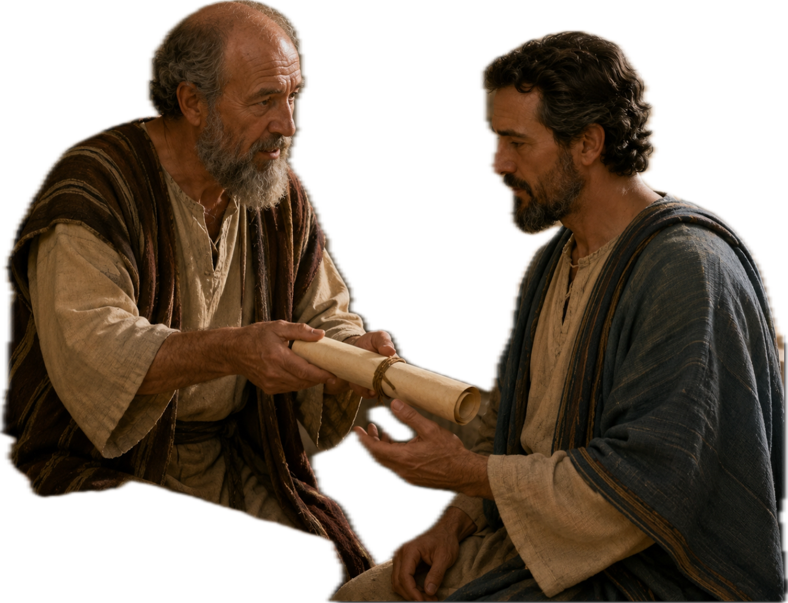
A final endearing word to a son…
1 Timothy 1:2 NKJ
To Timothy, A TRUE SON in the faith...
2 Timothy 1:2 NKJ
To Timothy, A BELOVED SON…
2 Timothy 2:1 NKJ
You therefore, MY SON,
BE STRONG IN THE GRACE that is in Christ Jesus.
Notes:
1 Tim. 1:2 & 2 Tim. 1:2 = I’d like to highlight this difference from the first letter to the second, final letter. I pose to you that our theme: “Rightly Dividing The Word”, is a theme of course of Hermeneutical refinement & proper exegesis.
And yet, there’s a deeper tone happening here that we need to capture.
First letter: <<A TRUE SON>>, Second letter: <<A BELOVED SON>>
→ I pose to you that there’s a deeper tone, a heightened, echoing word from Paul to Timothy. Paul knows he’s leaving…he’s now reassessed, reappraised Timothy’s value.
<<BELOVED>> is his chosen word. (Much loved, dearly loved)
YOU ARE BEING TAUGHT BY OLDER MEN…SOME POSSIBLY ON THEIR WAY OUT.
→ You are extremely precious to us. <<BELOVED>>

Slide 3
Paul’s Paternal Care…
I do not write these things to shame you,
but as my beloved children I warn you.
15 For though you might have TEN THOUSAND INSTRUCTORS IN CHRIST, YET YOU DO NOT HAVE MANY FATHERS;
for in Christ Jesus I have begotten you through the gospel.
1 Corinthians 4:14-15 NKJ
Notes:
Paul’s Paternal Care:
1 Corinthians 4:14-15 <<I do not write these things to shame you, but as my beloved children I warn you. 15 For though you might have ten thousand instructors in Christ, yet you do not have many fathers; for in Christ Jesus I have begotten you through the gospel.>> (2 Tim. 4:6 = Drink offering; Philip. 2:17)
Paul knows what’s at stake here, and the answer to the situation is TIMOTHY.
2 TIMOTHY 2:1 = Paul admonishes Timothy to <<BE STRONG>>. This would not be an automatic thing for Timothy, nor for anyone of us. It requires a deliberate & intentional effort from Timothy. (Pastoral role is not “automatic”).
Some say Timothy was timid. Whether that’s true or not, BEING STRONG is not an automatic thing for anyone pursuing the pastoral role.
(We’re not here to discourage your endeavor, but if we do…you shouldn’t be in this)

Slide 4
I. STAND FOR AN AUDIENCE OF ONE
2 Timothy 2:15 NKJV
Be diligent to present yourself APPROVED TO GOD…
Galatians 1:10
1 Thessalonians 2:4
2 Timothy 1:6
Proverbs 29:25
Romans 10:17
Joshua 1:8
Matthew 4:4
Acts 4:18-20
Mark 8:38
Notes:
1 TIMOTHY 1:6 = The pastoral role is not an automatic thing. Yet, we should we should consider a familiar Scripture. <<Therefore I remind you TO STIR UP THE GIFT OF GOD WHICH IS IN YOU through the laying on of my hands.>> “fan the flame”
NOTE: Paul is NOT introducing a “new ingredient” to accomplish the task. The ingredient is already in Timothy, but he must stir it up. The ingredient is THE HOLY SPIRIT. Older weathered men & women can assist, but we accomplish nothing without the Holy Spirit!
(John 15:5 without Me; Ps. 127:1 House; Pr. 21:31 Horse)
WHAT YOU NEED IS ALREADY IN YOU, JUST STIR IT UP!
1 Corinthians 9:27 = I discipline my body, bringing it into subjection, lest after I’ve preached to others, I myself am disqualified. I keep myself right with God.

Slide 5
I. Stand for an Audience of One (cont.)
THE FEAR OF MAN BRINGS A SNARE,
But whoever trusts in the Lord shall be safe.
Proverbs 29:25 NKJ
For whoever is ashamed of Me and My words
in this adulterous and sinful generation,
OF HIM THE SON OF MAN ALSO WILL BE ASHAMED
when He comes in the glory of His Father
with the holy angels.”
Mark 8:38 NKJ
Notes:
PROVERBS 29:25 = The old adage is true, “Stand for nothing, you fall for anything”. <<The fear of man brings a snare, But whoever trusts in the Lord shall be safe.>>
***Partaking of Communion. Exclusivity. Minister’s mother-in-law visiting. Don’t hurt her feelings. We gave brief study. She asked for notes for her pastor.***
Acts 4:18-20 = The disciples were threatened to not speak of the Name of Jesus, but they said, “Judge for yourselves, should we listen to God or man?”
Mark 8:38 – The alternative is dreadful: <<For whoever is ashamed of Me and My words in this adulterous and sinful generation, of him the Son of Man also will be ashamed when He comes in the glory of His Father with the holy angels.”>>
STAND FOR AN AUDIENCE OF ONE. <<APPROVED TO GOD>>

Slide 6

II. WHY IT MATTERS TO STAND, AND NOT SWERVE
Hebrews 4:12
Acts 20:25-31
2 Timothy 3:16-17
Proverbs 4:25-27
1 Timothy 4:16
Isaiah 40:6-8
Daniel 12:3
Ecclesiastes 12:11
2 Timothy 2:15 NKJV
Be diligent……RIGHTLY DIVIDING the word of truth.
(Vs. 17-18)
…their message will SPREAD LIKE CANCER.
Hymenaeus and Philetus are of this sort,
18 who have strayed concerning the truth…
Notes:
2 TIMOTHY 2:15 = The term “RIGHTLY DIVIDING” is “to cut straight”. Associated with: Skillful wielding of a sword, the farmer cutting straight furrows, a priest dissecting the sacrificial animal. Skillful work. CUT STRAIGHT.
Timothy was handling a cutting device set on people’s eternity: Hebrews 4:12
<<For the word of God is living and powerful, and sharper than any two-edged sword, piercing even to the division of soul and spirit, and of joints and marrow, and is a discerner of the thoughts and intents of the heart.>>
(Luke 22; John 18 – Peter had a sword…cut of the priest’s servant’s ear, the Lord reattached it. Rom. 10:17 – How many ears haven’t been mistakenly slashed?)
CUT STRAIGHT, DON’T SWERVE! – Proverbs 4:25-27 (If the salt loses its saltiness)

Slide 7
II. Why it matters to Stand, and Not Swerve (cont.)
Take heed to yourself and to the doctrine.
Continue in them, for in doing this you will
SAVE BOTH YOURSELF AND THOSE WHO HEAR YOU.
1 Timothy 4:16 NKJ
Those who are wise shall shine
Like the brightness of the firmament,
And those who turn many to righteousness
LIKE THE STARS FOREVER AND EVER.
Daniel 12:13 NKJ
Notes:
(If the salt loses its saltiness)
2 TIM. 2:17-18 = Two who swerved <<strayed>>, and the damage will spread.
Salvation is at stake for all if we swerve! 1 Timothy 4:16
<<Take heed to yourself and to the doctrine. Continue in them, for in doing this you will save both yourself and those who hear you.>>
Daniel 12:3 = In ancient times, true navigation was found in elements of the sky.
<<Those who are wise shall shine Like the brightness of the firmament, And those who turn many to righteousness Like the stars forever and ever.>> Sure markers!
Ecclesiastes 12:11 <<The words of the wise are like goads, and the words of scholars are like well-driven nails, given by one Shepherd.>>
(Acts 20:25-31 – Not shunned to declare the whole counsel of God; 2 Tim. 3:16-17 –All Scripture inspired by God; Prov. 4:25-27 – Don’t turn to right or left; Is. 40:6-8 The flower fades). IT ALL MATTERS FOR YOU, YOUR FAMILY & OTHERS…

Slide 8
III. CHARACTERISTICS OF AN APPROVED WORKMAN
2 Timothy 2:15 NKJV
Be diligent to present yourself….
…A WORKER who does NOT need to be ASHAMED…
Matthew 16:24
Joshua 5:13-14
John 8:32
1 Corinthians 9:27
2 Timothy 4:1-3
Ecclesiastes 11:4
Matthew 25:23
→ Good Soldier (Vs.3-4)
→ Compliant Athlete (Vs.5)
→ Diligent Farmer (Vs. 6)
Notes:
Paul brings forth these three examples of an approved characteristic:
Good Soldier – <<MUST endure hardship>> His commitment is not optional, can’t get entangled in civilian commitments. It’s more than just wearing a uniform a parade. Expression formed during war-time, “There’s a war is going on.”
Joshua 5:13-14 – The Lord presented Himself before Joshua. “Are you with us or our enemy?” <<…“No, but as Commander of the army of the Lord…And Joshua fell on his face to the earth and worshiped…>> A good soldiers knows who’s in control!
Compliant Athlete - <<…not crowned UNLESS he competes according to the rules>> Paul mentioned track & field (1 Cor. 9:24); Boxing (1 Cor. 9:26); wrestling (Eph. 6:12). We’ve all heard individuals disqualified…cheating, drug enhancement, false documentation. Shamefully stripped of medals.
Diligent Farmer - <<…MUST be first to partake of the crops.>> The season doesn’t align to the farmer, the farmer MUST align to the season. Plowing, seeding, watering. YOU MUST STAY SUBJECT TO THE SEASON!

Slide 9
III. Characteristics of an Approved Workman (cont.)
But I discipline my body and bring it into subjection,
LEST, when I have preached to others,
I MYSELF SHOULD BECOME DISQUALIFIED.
1 Corinthians 9:27 NKJ
I charge you therefore before God and the Lord Jesus Christ, who will judge the living and the dead at His appearing and His kingdom:
2 PREACH THE WORD! Be ready in season
and out of season. Convince, rebuke, exhort,
with all longsuffering and teaching.
2 Timothy 4:1-3 RVR
Notes:
1 Corinthians 9:27 = I discipline my body, bringing it into subjection, lest after I’ve preached to others, I myself am disqualified. KEEP YOURSELF COMPLIANT!
2 Timothy 4:1-3 – Season to preach! <<Preach the word! Be ready in season and out of season. Convince, rebuke, exhort, with all longsuffering and teaching.>>
(Matt. 16:24 – Take up your cross; Jn. 8:32 – Ashamed of Son; Ecc. 11:4 – Watch wind will not plow; Matt. 25:23 – Good and faithful servant)

Slide 10
IV. CHOOSING OUR OWN STEWARDSHIP DESIGN
2 Timothy 2:20-21 NKJV
But IN A GREAT HOUSE there are not only vessels
of gold and silver, but also of wood and clay,
some for HONOR and some for DISHONOR.
21 Therefore if anyone CLEANSES HIMSELF from
the latter, he will be a vessel for honor,
sanctified and useful for the Master,
prepared for every good work.
Notes:
GOD’S HOUSE IS A GREAT HOUSE! Planned, designed & built by God.
(Matthew 16:18 – Upon this rock I will build my church; 1 Peter 2:5 – We, as living stones, are built up a spiritual house)
IN A GREAT HOUSE THERE ARE VESSELS OF HONOR & DISHONOR:
Matthew 13:24-30 – Parable of the field with good seed…an enemy sowed tares.
“Should we pull out the weeds?...No, you’ll uproot the wheat if you do”
→ Don’t be surprised with the vessels of dishonor.
THE KEY THEME HERE TO GRASP IS THAT THE CHOICE IS OURS:
<<…if anyone cleanses himself…he will be a vessel of honor>>
Jude 1:21 <<keep yourselves in the love of God…>>
Philippians 2:12 <<…work out your own salvation with fear and trembling>>
1 Jn 3:3 <<…everyone who has this hope in Him purifies himself, just as He is pure>
2 Timothy 2:19 = Dual seal on God’s foundation: 1st The Lord knows who are His, 2nd Depart from iniquity.
Matthew 25:31-32 = When the Son of man returns with his angels, all nations gathered and as a shepherd separates the sheep & the goats. Sheep to the right and goats to the left. <<AS A SHEPHERD>> The shepherd doesn’t make them one way or another, he just separates them.
Who they are has already been determined…BY THEM!

Slide 11

2 Timothy 1:7 NKJ
For God has not given us a spirit of fear,
but of power and of love and of a sound mind.
Notes:
NO NEW INGREDIENT…IT’S ALREADY IN YOU! JUST STIR IT UP.

