Slide 1
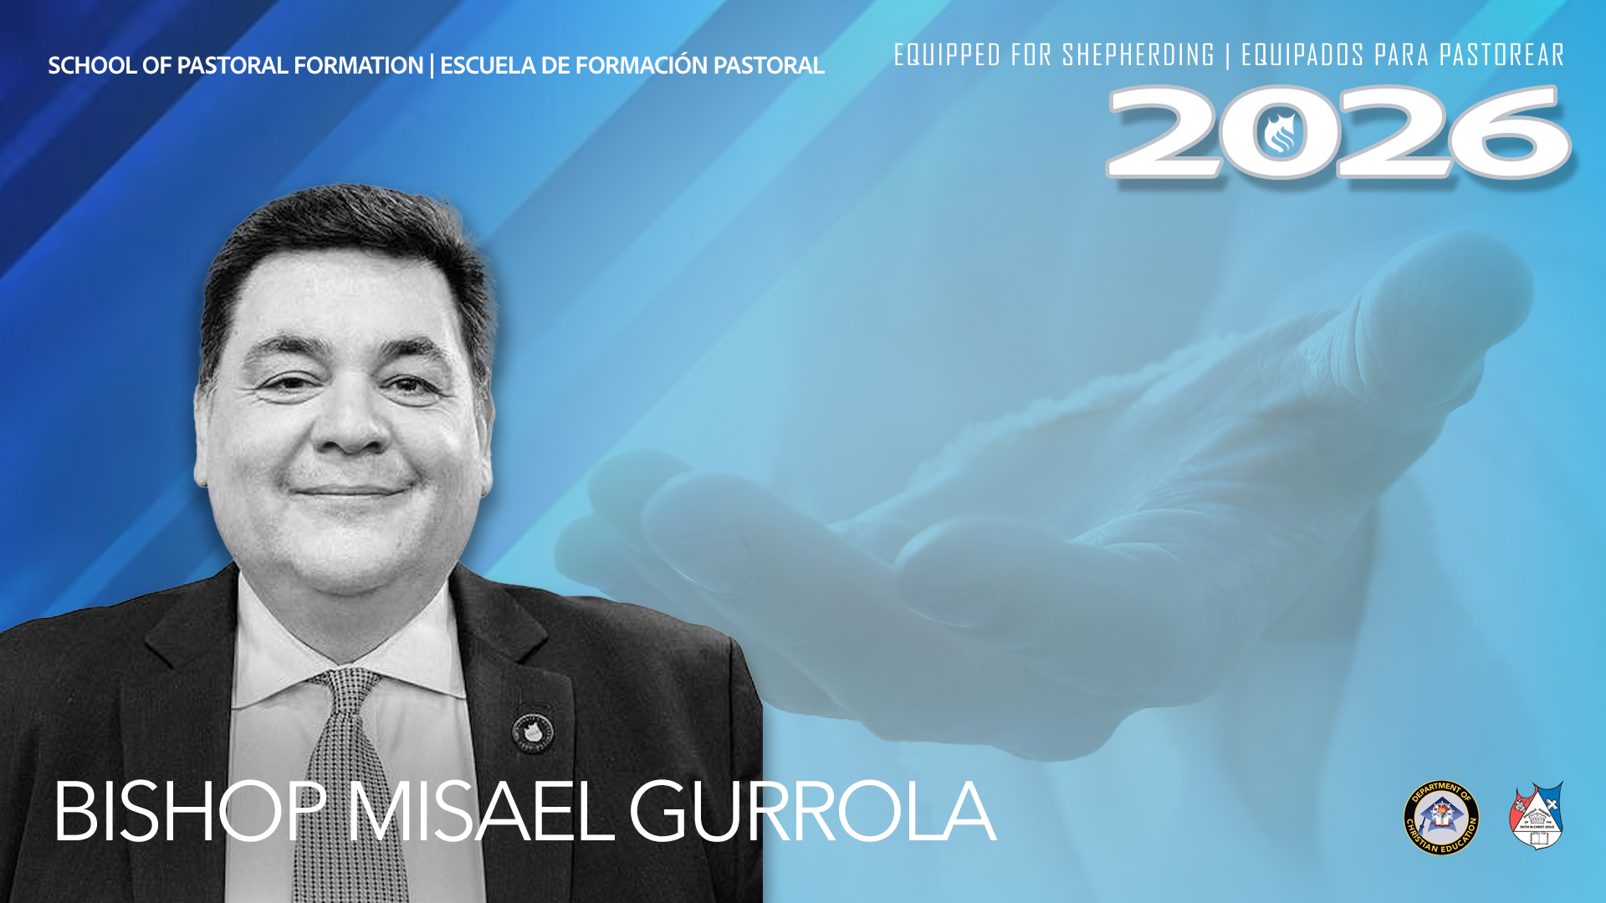
SCHOOL OF PASTORAL FORMATION
Disciplined Prayer

Slide 2
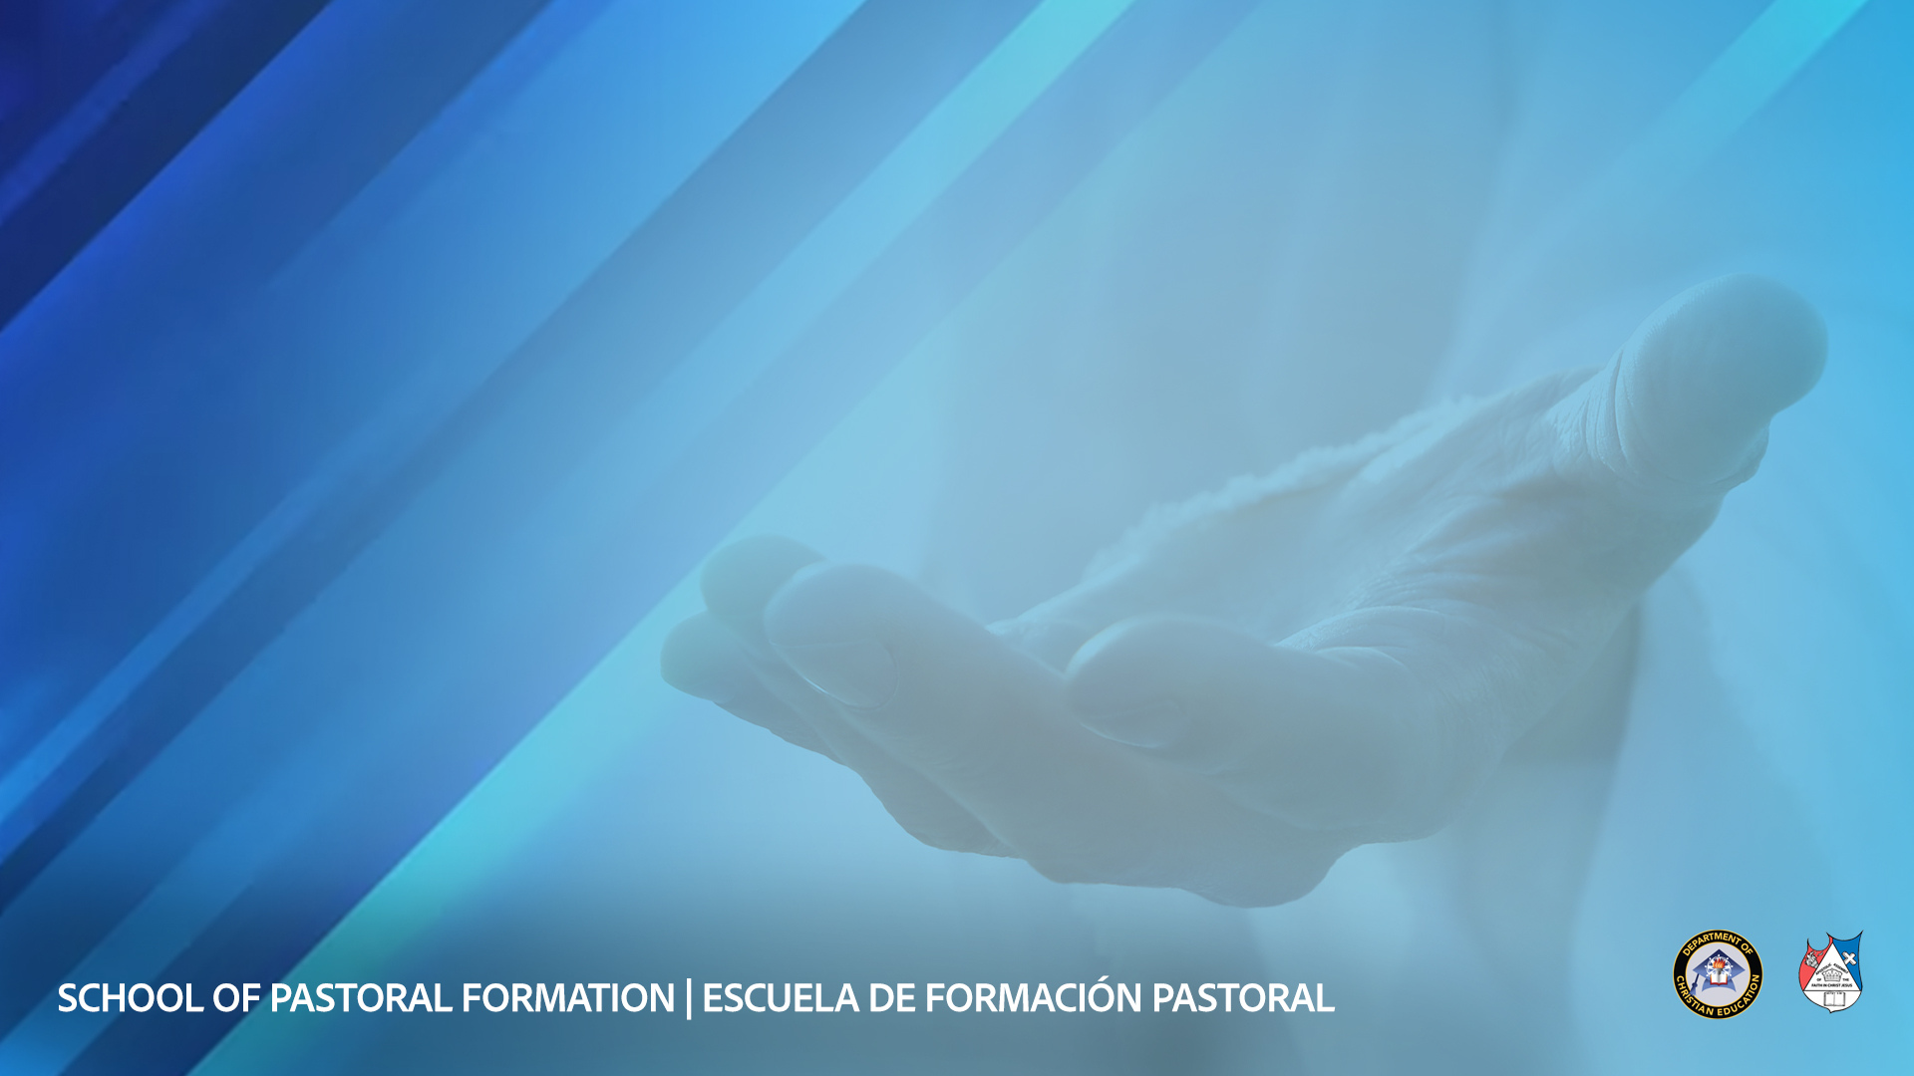
The Question That Reveals Everything
They watched Jesus preach, heal, raise the dead — then asked one question: ‘Lord, teach us to pray’ (Luke 11:1)
Not to preach. Not to lead. Not to organize.
They had traced everything visible back to something invisible.

Slide 3
RESEARCH
Reality Check
Only 16% of pastors describe themselves as ‘very satisfied’ with their prayer lives — 37% are dissatisfied
The average pastor prays 39 minutes per day. 21% pray less than 15 minutes.
Pastors with consistent, deeper prayer lives report significantly lower burnout rates and longer ministry tenure
Source: Ellis Research for Facts & Trends; Soul Shepherding Pastoral Stress Research; Barna Group

Slide 4
PART One
What Prayer Actually Is
Theology before discipline

Slide 5
“
What comes into our minds when we think about God, is the most important thing about us.
— A.W. Tozer, The Pursuit of God

Slide 6
Prayerlessness Is a Theology Problem First
Prayer is communion — the natural expression of a creature’s relationship with its Creator
A thin prayer life reveals a thin theology of God, not a lack of willpower
Augustine: ‘Thou madest us for Thyself, and our heart is restless, until it repose in Thee’

Slide 7
Why God Commands Prayer Even Though He Already Knows
God does not need the information — He commands prayer because the relationship requires conversation
Jeremiah 33:3: ‘Call to Me and I will answer you’ — a sovereign God bending toward His creatures
Prayer is not information transfer. It is the conversation that sustains the relationship.

Slide 8
The Forms of Prayer
Adoration — begin with God, not need. Trains the pastor’s heart before he brings his requests
Confession — specific repentance. Keeps the relationship honest, not transactional
Intercession — praying for others. Participation in what the risen Christ does (Romans 8:34)

Slide 9
PART Two
The Pastoral Accountability
1 Samuel 12:23 • Acts 6:4

Slide 10
1 Samuel 12:23 — The Weight of Prayerlessness
"Far be it from me that I should sin against the LORD by ceasing to pray for you."
Samuel uses the word chata — the Hebrew word for transgression against God.
Not negligence. Not a spiritual lapse. Sin.
The congregation you will one day serve has a rightful claim on your intercession — not just your preaching, but your prayer.

Slide 11
“
Talking to men for God is a great thing, but talking to God for men is greater still.
— E.M. Bounds, Power Through Prayer

Slide 12
The Apostolic Priority and Its Consequence
Acts 6:4 — prayer listed first, before the ministry of the Word.
The prayer culture of a congregation is set by who the pastor is in private
Only 16% of pastors are satisfied with their prayer lives. You are building now the habits you will carry into ministry.

Slide 13
PART Three
What Prayer Does to the Man Who Prays
2 Corinthians 3:18

Slide 14
2 Corinthians 3:18 — Transformed by Beholding
"But we all, with unveiled face, beholding as in a mirror the glory of the Lord, are being transformed (metamorphoo) into the same image from glory to glory."
The mechanism is not effort or discipline — it is sustained beholding.
You become, over time, what you consistently and attentively gaze upon.

Slide 15
Robert Murray M’Cheyne
Ordained at 23, died at 29 — saw Dundee, Scotland shaken by revival in six years of ministry
Before he spoke a word, congregations felt they were in the presence of someone who had been with God
That was not natural magnetism. That was what years of prayer do to a human face.

Slide 16
“
What a man is alone on his knees before God, that he is, and no more.
— Robert Murray M’Cheyne

Slide 17
“
The pulpit without the prayer closet behind it is a man speaking in his own name. The unction, the earnestness — these are not produced in the study. They are produced on the knees.
— C.H. Spurgeon, Lectures to My Students

Slide 18
PART Four
Building the Discipline
Before You Need It

Slide 19
The Lord’s Prayer — Architecture, Not Formula
A map, not a formula: Adoration → Surrender → Dependence → Confession → Petition → Praise (Doxology)
Begins with God, ends with God. Every request framed by who He is.
Müller: Scripture first for soul food — then pray from what God opens. The conversation flows from encounter.

Slide 20
The Structure That Sustains a Praying Life
Fixed time — a protected daily appointment before the day begins, not ‘when I can fit it in’
Fixed place — Matthew 6:6: the inner room. Consistency of place trains consistency of practice.
The average pastor prays 39 min/day. Luther prayed 3 hours. Intercession by name — pray for your congregation specifically and persistently.

Slide 21
Two Failure Modes Every Pastor Must Know
Prayer as professional preparation — using prayer to prep sermons, not to meet God
Prayer as performance — organized around being heard by others, not by God (Matthew 6:5)
The cure for both: more private prayer. The man who has met God in secret has nothing to prove in public.

Slide 22
“
To pray is to change. Prayer is the central avenue God uses to transform us. If we are unwilling to change, we will abandon prayer as a noticeable characteristic of our lives.
— Richard Foster, Celebration of Discipline

Slide 23
A PASTORAL CHARGE
Be the man who meets with God before he meets with them.
Rise before they do.
Pray for them by name.
Let what you are in secret be worth becoming.
They deserve a pastor who has been with God.

