Slide 1


Slide 2

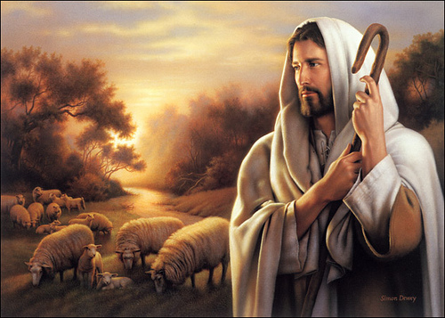
Are
You
Called
To
Pastoral
Ministry?

Slide 3
Ephesians 4 -- Now these are the gifts Christ gave to the church: the apostles, the prophets, the evangelists, and the pastors and teachers.
¹² Their responsibility is to equip God’s people to do his work and build up the church, the body of Christ.
¹³ This will continue until we all come to such unity in our faith and knowledge of God’s Son that we will be mature in the Lord, measuring up to the full and complete standard of Christ.

Slide 4
Hebrews 5
Every high priest is selected from among the people and is appointed to represent the people in matters related to God…
4 And no one takes this honor on himself, but he receives it when called by God, just as Aaron was.

Slide 5
A pastoral calling is a theological, divine vocation —not a job or a career — focused on shepherd-leadership, teaching the Gospel, and serving God's people.
It involves a compelling inward desire, demonstrated gifts, and an outward confirmation from the church.
It requires maintaining integrity, upholding sound doctrine, and fostering resilience amidst high-responsibility challenges.

Slide 6
Discerning the Call
Discerning the call to ministry involves both internal conviction and external recognition.
•Inward Desire: An intense, almost irresistible pull toward ministry that persists over time.
•Character and Gifting: Possessing the necessary spiritual gifts (teaching, leadership, compassion) suitable for pastoral work.
•Outward Affirmation: Validation from church leaders, mentors, and the congregation.

Slide 7
Signs of a Pastoral Vocation
God has placed in your heart a desire to be a pastor ...
The desire does not go away…
You can’t see yourself doing anything else…
You have a deep love for Christ, his word and His Church ...
Other people have mentioned that you would be a good pastor ...
You desire to live a model life of virtue, prayer, and Scriptures ...
You want to help others grow closer to Christ…

Slide 8
How can you know if you are truly called to be a pastor? Here we explore the spiritual signs and practical steps that can help you discern your vocation.
I. Spiritual Signs of a Pastoral Calling
1. A Deep Love for the Church
A future pastor feels a genuine love for the Church — not just for the institution, but for the people who make it up.

Slide 9
I. Spiritual Signs of a Pastoral Calling
2. A Holy Burden for the Care of Souls
Beyond the desire to preach, there is an internal burden for the spiritual well-being of people. You feel a sacred responsibility to see others grow in their faith.

Slide 10
I. Spiritual Signs of a Pastoral Calling
3. A Conviction That Does Not Go Away
Perhaps you have tried to ignore the impulse to pastor, but the conviction returns again and again.
It is a persistence that seems to come from something — or Someone — greater than yourself.

Slide 11
I. Spiritual Signs of a Pastoral Calling
4. External Confirmation
God often uses others to confirm a calling.
Have pastors, mentors, or members of your church recognized leadership, teaching, or pastoral care gifts in you?

Slide 12
II. Practical Aspects to Discern Your Pastoral Calling
1. Evaluate Your Gifts and Abilities
Are you able to clearly communicate biblical truths?
Do you naturally feel drawn to counsel and encourage others in their faith?

Slide 13
II. Practical Aspects to Discern Your Pastoral Calling
2. Seek Leadership Experiences
Serve in your church’s ministries.
Lead small groups, teach Bible classes, participate in pastoral visits. – (Homes & hospitals)
These practical experiences will help you confirm or redirect your calling.

Slide 14
II. Practical Aspects to Discern Your Pastoral Calling
3. Study the Word
A pastor must be “able to teach” (1 Timothy 3:2).
If you have a constant hunger to go deeper into Scripture and a passion to teach it faithfully, this could be an indicator that God is preparing you for ministry.

Slide 15
II. Practical Aspects to Discern Your Pastoral Calling
4. Reflect on Your Willingness to Serve
Pastoral leadership is not a path of recognition, but of sacrificial service.
Are you willing to invest your life in others, even when the work is hard and unrecognized?

Slide 16
III. Questions You Can Ask Yourself to Evaluate Your Pastoral Calling
Do I feel a persistent desire to spiritually care for others?
Do I like being around people?
Do the spiritual leaders who know me affirm that I have pastoral gifts?
Am I willing to spend time preparing and being formed?
Can I see myself doing anything else?

