Slide 1
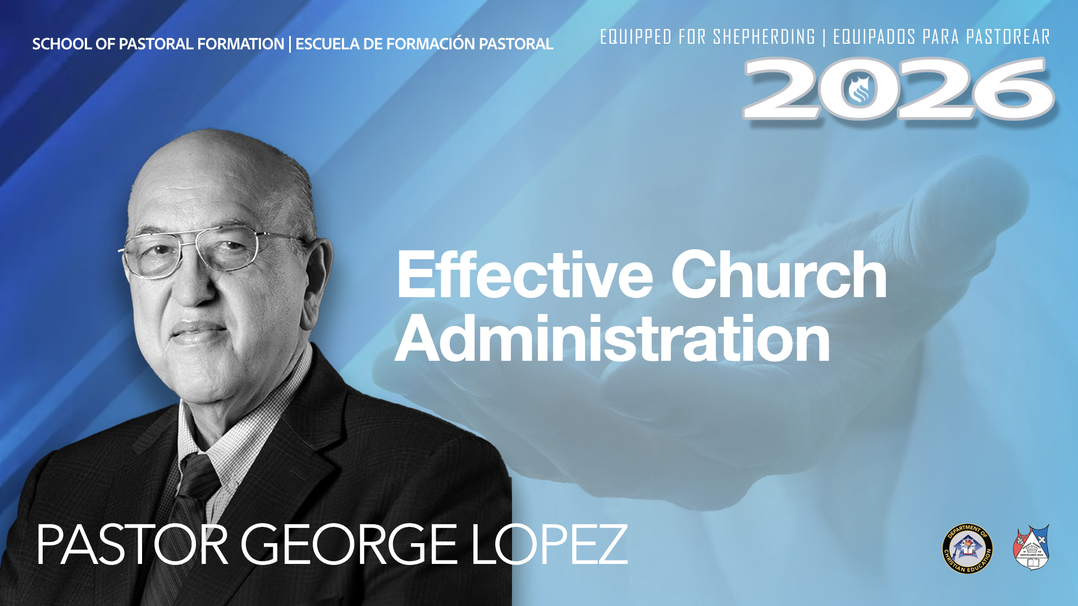

Slide 2

Church Administration
Objective
The objective of this presentation is to present a platform for an Apostolic Church to implement an administration that is structured adherence to the Constitution of the Apostolic Assembly and other practical applications.
Verify pricing and license terms before purchase.

Slide 3
Pastors Article 76 (77 Read)
REQUIREMENTS TO BE A PASTOR
1. Be an ordained minister and have the moral and spiritual qualities prescribed by the Word of the Lord Jesus Christ (1 Timothy 3:1-7; Titus 1:5-9; and 1 Peter 5:1-3).
2 . Be an ordained minister and have the moral and spiritual qualities prescribed by the Word of the Lord Jesus Christ (1 Timothy 3:1-7; Titus 1:5-9; and 1 Peter 5:1-3).
2. Be at least twenty-two years of age.
3. Having served satisfactorily in the ministry of the Apostolic Assembly for a period of four years.
4. Having served satisfactorily in the ministry of the Apostolic Assembly as a co-pastor or assistant pastor
for one year.
5. Marital Status: married. a pastorate, he shall have his two-year probationary period to meet this requirement.
6. His wife must have a good testimony, be baptized for
at least three years, and received the gift of the Holy Spirit, with the evidence of speaking in other tongues
7. Be faithful in having paid his tithes.
8. Be in agreement with the doctrinal, organizational, economic, and disciplinary system of the Apostolic Assembly.
9. Be in agreement that his designation, for two (2) years,
is provisional based on what is stipulated in Article 60, Clause VII. He must also agree with the stipulations of Article 61, Clause I of this Constitution.
10. Be approved by his pastor and District Bishop, with
prior authorization of the Bishop President.
11. Must have completed four years of studies of the Bachelor of Theology degree through the International Apostolic Bible College. This agreement shall commence on November 26, 2014 and shall not be retroactive.
Upon assuming a pastorate, he shall have his two-year probationary period to meet this requirement.
Verify pricing and license terms before purchase.

Slide 4
Treasury
.
Opening a Bank account – Articles of Incorporation & EIN- call the general offices of the Apostolic Assembly.
Recommendations:
The pastor should be the “Key Account Person”
The treasurer should be a member in good standing
The treasurer should not be a relative to the pastor in order to preserve the independence and avoid nepotism.
There should be 2 signers on the bank account, and the treasurer should execute the transactions.
Many churches pay the treasurer a stipend.
There should be a “view only” account person to match the offerings to the bank account and other transaction.
Verify pricing and license terms before purchase.

Slide 5
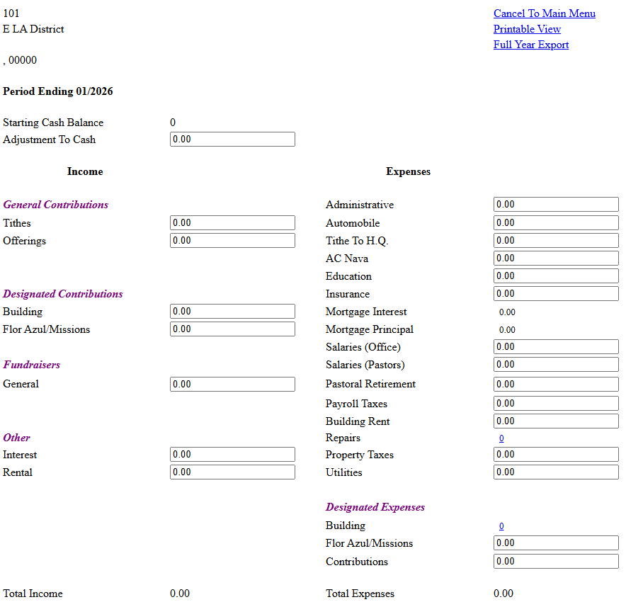
ARIS Report
.
The ARIS report should be completed shortly after the month expires www.aaofcj.com / Resources / ARIS Reporting / Monthly Reporting
The “Starting Cash Balance” and the “Ending Cash Balance” should agree with the total of all of your bank statements. Ask your district treasurer for assistance if you need it.

Slide 6
National and District Obligations
.
Each Pastor should pay their personal tithes to the District monthly.
Church should pay 10% of their local tithes to the Apostolic Assembly monthly.
Churches should pay programs or costs approved by the pastors of the district including quotas.
Churches should pay pastors retirement, if funds allow: (Articles 20:VII)
  1st to 10 year – 5%
  11th to 20st year – 7%
  21st and above – 10%
Any financial agreements made between the congregation and the pastor should be forwarded to the District for approval.
To the best of each church’s ability, each church should make an effort to support national or district programs such as Flor Azul, etc.

Slide 7
Annual Ministry Licensing
.
  Each year the ministers’ licenses must be renewed requiring:
    Mandated Reporter Course Certificate
    Protection from Sex Abuse Course Certificate
    Live Scan for any change in ministers’ license
  Once a week, the church is required to send the report on all activities that include minors to the portal of the Apostolic Assembly.
  Your district should have resources to assist.
  Any discrepancies or incidents that are questionable should be reported to the District.
Verify pricing and license terms before purchase.

Slide 8
Church Administration-Strategic Planning
Objective
The objective of this presentation is to present a platform for an Apostolic Church to implement an administration that is structured for consistent growth and stability based on the Word of God and the use the administrative tools that God gave to humanity.
Verify pricing and license terms before purchase.

Slide 9
The Vision
Church Administration
Where there is no vision, the people perish…Proverbs 29:18
Pray and fast for the answers to these questions:
Where would like to be in 1, 3, and five years from today? (members; buy, real estate or rent; ministries;

Slide 10
Building Gods Plan
Church Administration
You must have a plan if you are to succeed!
For which of you, intending to build a tower, sitteth not down first, and counteth the cost, whether he have sufficient to finish it? Lest haply, after he hath laid the foundation, and is not able to finish it, all that behold it begin to mock him, Saying, This man began to build, and was not able to finish. Luke 14:28-30
Planning must be done according to Gods will
Unless the Lord builds the house, those who build it labor in vain. Unless the Lord watches over the city, the watchman stays awake in vain. It is in vain that you rise up early and go late to rest, eating the bread of anxious toil; for he gives to his beloved sleep.

Slide 11
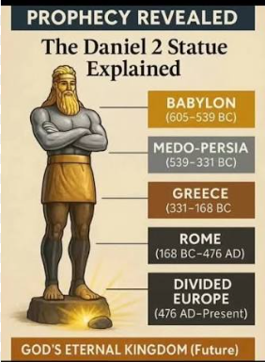

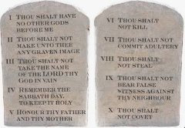
Building a Strategic Detailed Plan
Church Administration
God made detailed strategic Plans
God provided the exact measurements for Noah's Ark
God provided the clear the Laws of Moses
God mostly communicated His plans IN WRITING

Slide 12
Why Churches Do not Grow
Church Administration
There are about 350,000 Christian congregations in the United States. The average congregation is about 65 to 70 weekly attendees for Christian churches in the United States. About 5% go to church weekly
In the city of Santa Ana California with about 310,000 population, there are about 150 congregations. 3%-4% of the population go to church.
In the city of La Habra California with about 61,000 population, there are about 37 congregations. 3%-4% of the population go to church.

Slide 13

Why Churches Do not Grow
Church Administration
One pastor usually can serve 65-100 members
How can we solve this problem?
65-100 members
By setting up an administration with a strategic plan

Slide 14
Components of a Strategic Plan
Church Administration
EXAMPLE PLAN FOR A CHURCH OF 65 MEMBERS
(Note: There is no one plan that fits all churches. There are many factors that should be considered for any given plan, however, there are also many similar processes that occur in Apostolic churches
Mission Statement (example: Worship, Discipleship, and Evangelism)
Resources (example: 65 members, music, teachers, ministers, funds, technology, etc.) In other words, what do you have to work with?
Objectives (Note “objectives” are more general in nature)
  Holy Spirit driven church
  Strong discipleship system
  Strong administration and membership growth
Critical Factors
Goals 1st year
  Develop 10 strong spiritual leaders
  Organize the administration , document systems, rules, norms within 4 months
  30 baptisms within one year that the setup for administration is done.
First year’s plan (next slide)

Slide 15
Components of a Strategic Plan
Church Administration
6. First year's plan (Cont.)
1. Change church culture from traditional to an evangelistic church
2. Create standards for the “Member with Ministry” versus “Member”
a. Members with ministry will take x Bible courses or seminars
b. Members with ministry will abide by modesty standards etc.
c. Train for leadership, evangelism, and cell ministry
7. Modify plan as you go to your strategic plan
8. Create “job descriptions” for every position
9. Upgrade the Social Media

