Slide 1

Starting an English Ministry in My Church
Building One Church in Two Languages

Slide 2
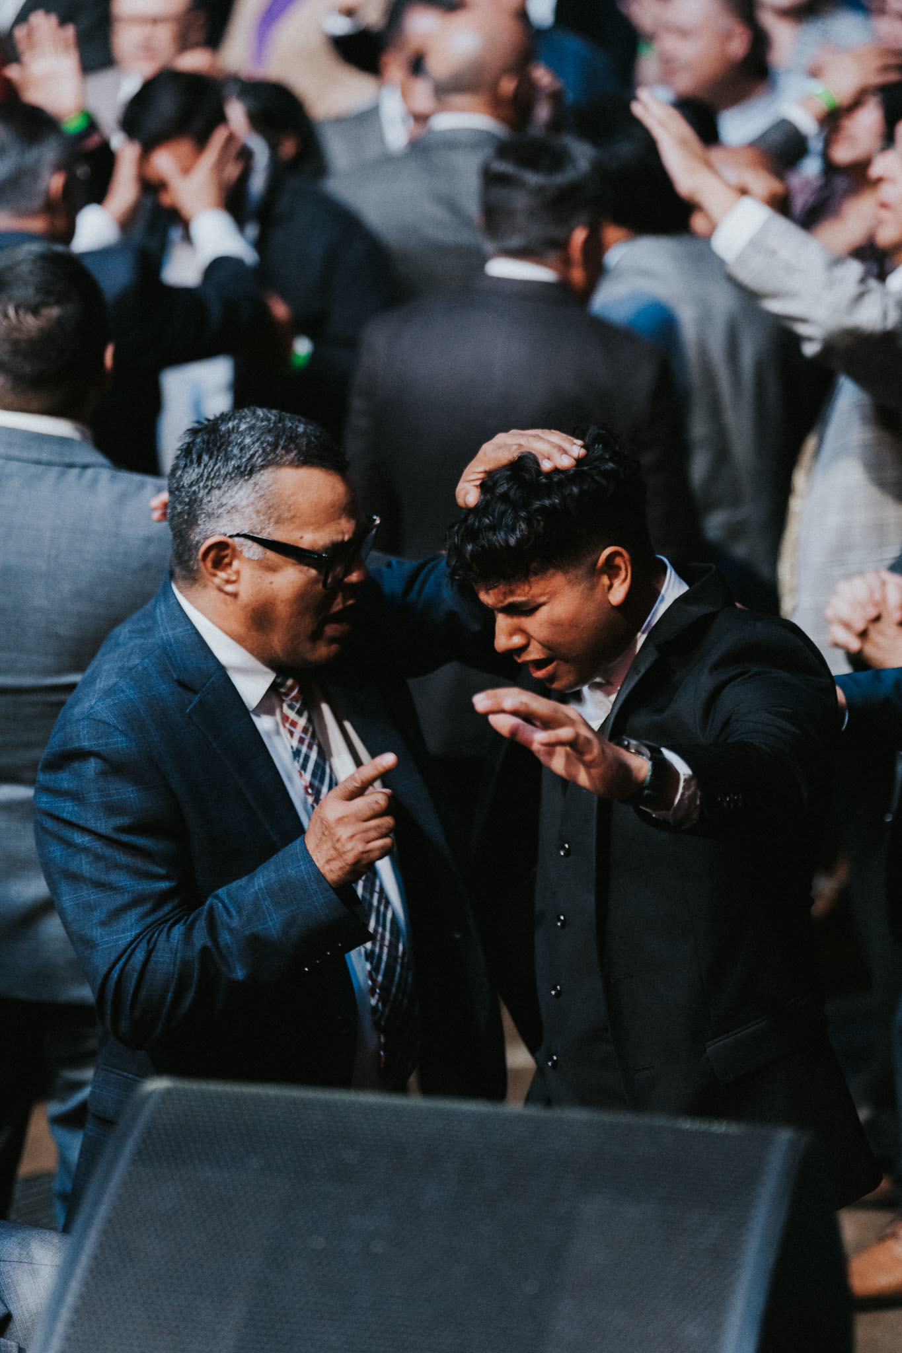

Why English Ministry Is Essential
The future growth of many Spanish-speaking congregations depends on their ability to reach and retain the next generation. First-generation immigrants often prefer Spanish — but their children and grandchildren communicate, learn, and worship more naturally in English.
"I am made all things to all men, that I might by all means save some." — 1 Corinthians 9:22
If we do not intentionally disciple the next generation in English, another church eventually will.

Slide 3
One Church, One Mission — Two Languages
The goal is not to create two churches under one roof, but one church with one doctrine, one vision, and one mission expressed in two languages.
Biblical Model
Cultural Reality
Apostolic Principle
Acts 6: The Jerusalem church recognized the needs of Hebrew and Hellenist groups — adjusting structure without compromising unity or doctrine.
Culture includes communication style, music, illustrations, relationships, and life experiences. The Gospel never changes — methods often do.
Acts 17:22–23: Paul adjusted his presentation to connect with Athens while preaching the same Gospel. The message stays Apostolic; the method becomes culturally relevant.

Slide 4
English Ministry Is Evangelism
More Than Retention
Who Can We Reach?
Many churches view English ministry as a way to keep their children. That is only half the mission.
Neighbors and co-workers
Friends of church youth
College students
Young families
"Go ye into all the world, and preach the gospel to every creature." — Mark 16:15
Young adults are far more likely to invite friends when the service is in English and the message is relatable. John 1:41–42: Andrew found his own brother and brought him to Jesus — people naturally reach people within their own culture.

Slide 5



The Cost of Doing Nothing
Gen 1
Gen 3
Spanish-speaking immigrants
Primarily English-speaking
Gen 2
Gen 4
Bilingual children
Many leave for English churches
"There arose another generation after them, which knew not the LORD." — Judges 2:10
They often leave not over doctrine — but because they cannot understand the language, connect culturally, or invite their friends.

Slide 6
A Discipleship Responsibility
"Every church is only one generation away from extinction."
Unless the faith is intentionally transferred to the next generation, it will not survive. — Adapted from the principle throughout Psalm 78
"We will not hide them from their children, shewing to the generation to come the praises of the LORD." — Psalm 78:4
This reframes English ministry not merely as accommodation — but as both a discipleship responsibility and a missionary opportunity. For Apostolic churches in America, that is often the decisive argument.

Slide 7

Establishing the Vision & Leadership
Cast the Vision First
Leadership Structure
Many English ministries fail because they begin as a reaction to a problem rather than a vision. The pastor must answer: Why are we starting? Who are we reaching? What does success look like in five years?
01
Pastor
02
English Ministry Director
Bilingual, loyal to vision, able to preach in English
03
Ministry Team & Volunteers
Clear lines of communication prevent future conflict
Do not choose a leader simply because they speak English, are young, or are available. Choose character, competence, and a strong relationship with the pastor.

Slide 8
Building the Ministry Intentionally
Identity, Not Independence
Worship Strategy
The English ministry has its own style and discipleship process — but remains aligned in doctrine, vision, leadership, and mission.
Separate English services typically yield better communication, stronger ownership, and greater outreach potential — though they require more leaders.
Full Church Systems
Visible Presence
Build a complete pathway in English: Evangelism → Discipleship → Small Groups. The goal is not attendance — it is a fully functional, discipling congregation.
English signage, announcements, website, social media, discipleship materials, and outreach strategies. The English congregation must never feel like an afterthought.

Slide 9

Practical 12-Month Launch Plan
Months 1–3
1
Cast vision, identify leadership, train volunteers, survey English-speaking members
2
Months 4–6
Launch English Bible studies, form ministry team, develop discipleship materials
Months 7–9
3
Begin monthly English services, develop worship team, start outreach efforts
4
Months 10–12
Launch weekly English service, establish small groups, evaluate progress and adjust
Maintain a "One Church" culture throughout: one doctrine, one vision, one leadership structure — shared across both languages.

Slide 10
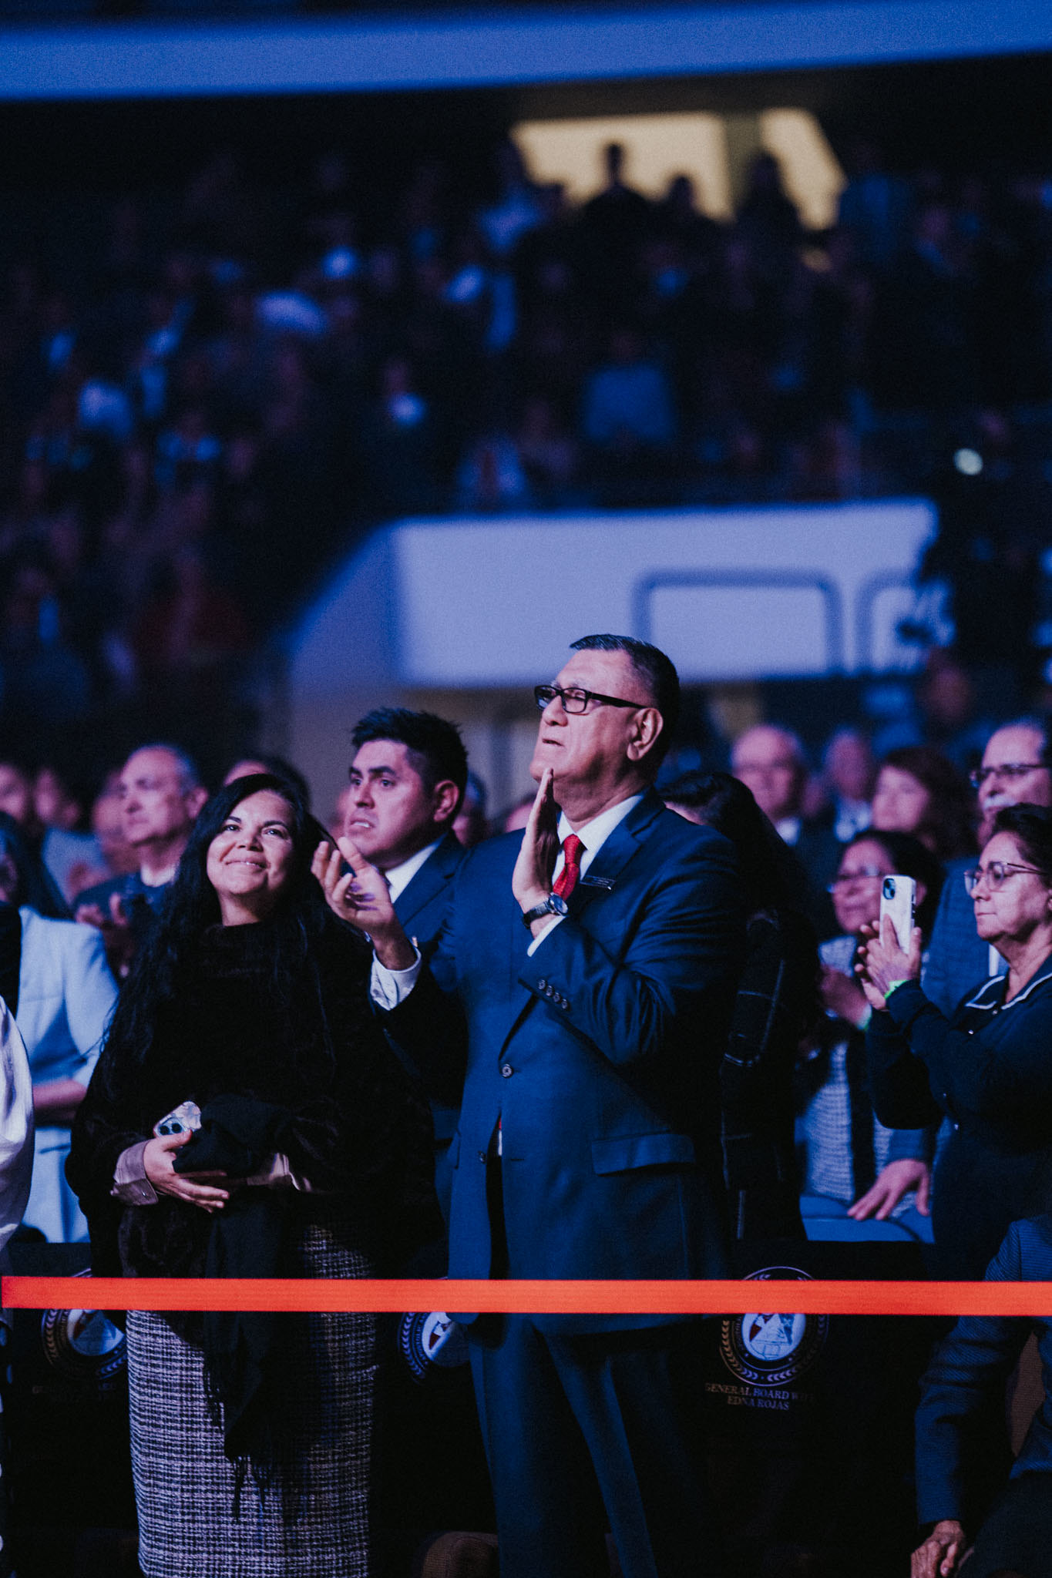
Conclusion: One Mission, Two Languages
The future of many Hispanic Apostolic churches depends on their ability to disciple the next generation. An English ministry is not merely a convenience — it is a missionary effort within our own congregation.
The goal is not to replace the Spanish ministry or create a competing congregation. The goal is to build a bridge between generations so that children, youth, young adults, and future families remain connected to the Apostolic faith.
Faithful Doctrine
Healthy Leadership
Intentional Discipleship
Unwavering Unity
One church. Two languages. One mission: making disciples of Jesus Christ.

